Slide 1
DC MOTOR INTERFACING WITH 8051
ACTUATOR

Slide 2
ACTUATOR
An actuator is a part of a device or machine that helps it to achieve physical movements by converting energy, often electrical, air, or hydraulic, into mechanical force. Simply put, it is the component in any machine that enables movement.
Actuator convert electrical signal into physical movement

Slide 3
DC MOTOR
A DC motor is a rotatory instrument that works on DC power to convert electrical energy into mechanical energy.
DC motors can vary in size and power from small motors in toys and appliances to large mechanisms that power vehicles, pull elevators and hoists, and drive steel rolling mills, etc.

Slide 4
Basics of DC motor
widely used device that translates electrical pulses into mechanical movement. (PWM)
has only + and – leads.
Connecting them to a DC voltage source moves the motor in one direction.
By reversing the polarity, the DC motor will move in the opposite direction.

Slide 5
DC MOTOR
DC motor converts electrical energy in the form of Direct Current into mechanical energy.
In the case of the motor, the mechanical energy produced is in the form of a rotational movement of the motor shaft.
The direction of rotation of the shaft of the motor can be reversed by reversing the direction of Direct Current through the motor.
The motor can be rotated at a certain speed by applying a fixed voltage to it. If the voltage varies, the speed of the motor varies.

Slide 6
Thus, the DC motor speed can be controlled by applying varying DC voltage; whereas the direction of rotation of the motor can be changed by reversing the direction of current through it.
For reversing the current, we can make use of an H-Bridge circuit or motor driver ICs that employ the H-Bridge technique or any other mechanisms.

Slide 7
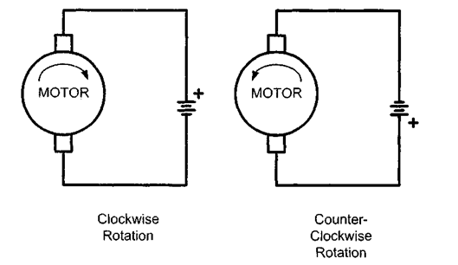
Unidirectional motor control

Slide 8
Terminal 1 connected to the positive terminal of DC supply & Terminal 2 is connected to a negative terminal or grounded: The shaft rotates in a clockwise direction.
Terminal 2 connected to the positive terminal of DC supply & Terminal 1 is connected to a negative terminal or grounded: The shaft rotates in an anti-clockwise direction.

Slide 9
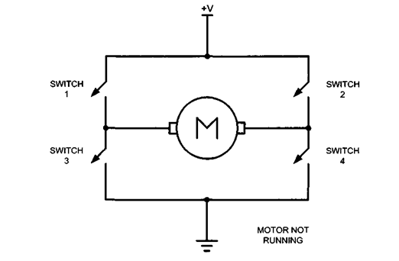
Bidirectional motor control

Slide 10
When the switches S1 and S4 are ON and switches S2 and S3 are OFF, the current flows from A to AA, and the motor rotates in one direction, say clockwise.
When the switches S2 and S3 are ON and switches S1 and S4 are OFF, the current flows from AA to A, and the motor rotates in the other direction, i.e., anti-clockwise.

Slide 11
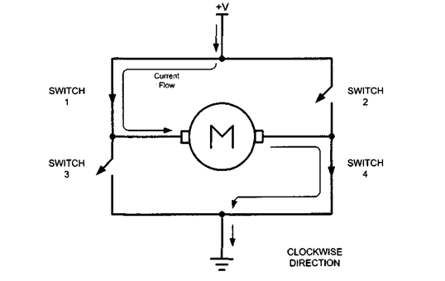
H-bridge L293D Motor Driver

Slide 12
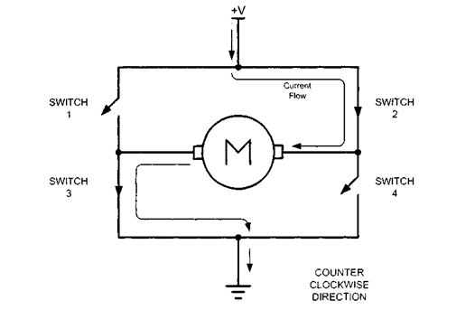

Slide 13
The L293D Motor Driver Module is a high-power motor driver module which is used to drive DC and Stepper Motors. It consists of an in-built +5V voltage regulator.
The L293D module can control up to four DC motors, or two DC motors with direction control and speed control because of its dual H-bridge circuit.

Slide 14
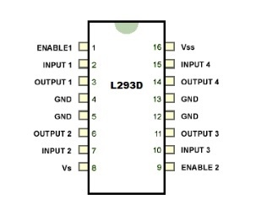
Bidirectional Motor Control Using an L293 Chip

Slide 15
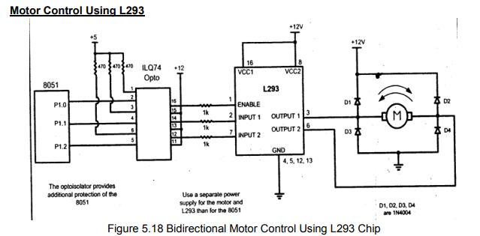
8051 INTERFACEING WITH DC MOTOR(L293)

Slide 16
Optoisolator:
An optoisolator (also known as optical coupler, optocoupler and opto-isolator) is a semiconductor device that uses a short optical transmission path to transfer an electrical signal between circuits or elements of a circuit, while keeping them electrically isolated from each other.
Advantage: Their high electrical isolation between the input and output terminals allowing relatively small digital signals to control much large AC voltages, currents and power.

Slide 17
Port pins P1.0 and P1.1 are connected to the corresponding input pins of the L293 motor driver.
The motor is connected across output pins 3 and 6 of the L293.

Slide 18
The software is so written that the logic combinations of P1.0 and P1.1 controls the direction of the motor.
Initially when power is switched ON, P1.0 will be high and P1.1 will be low.
This condition is maintained for a preset amount of time (around 1S) and for this time the motor will be running in the clockwise direction (refer the function table of L293).

Slide 19
Then the logic of P1.0 and P1.1 are swapped and this condition is also maintained for the same duration .
This makes the motor to run in the anti clockwise direction for the same duration and the entire cycle is repeated.

Slide 20
PWM: Pulse Width Modulation(PWM)
The speed of the motor depends on three factors
o Load
o Voltage
o Current
➢ For a given fixed load we can maintain a steady speed by using a method called Pulse Width Modulation(PWM)

Slide 21
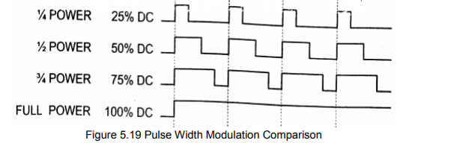

Slide 22
By changing (modulating) the width of the pulse applied to the DC motor we can increase or decrease the amount of power provided to the motor, thereby increasing or decreasing the motor speed.

Slide 23
➢ Notice that although the voltage has a fixed amplitude, it has a variable duty cycle
➢ That means the wider the pulse, the higher the speed.
➢ PWM is do widely used in DC motor control that some microcontrollers come with the PWM circuitry embedded in the chip.

Slide 24
DIGITAL-TO-ANALOG (DAC) CONVERTER
The DAC is a device widely used to convert digital pulses to analog signals.
The two method of creating a DAC is binary weighted and R/2R ladder.
The Binary Weighted DAC, which contains one resistor or current source for each bit of the DAC connected to a summing point.

Slide 25
binary weighted
These precise voltages or currents sum to the correct output value.
This is one of the fastest conversion methods but suffers from poor accuracy because of the high precision required for each individual voltage or current.
Such high-precision resistors and current-sources are expensive, so this type of converter is usually limited to 8-bit resolution or less.

Slide 26
R-2R LADDER DAC
The R-2R ladder DAC, which is a binary weighted DAC that uses a repeating cascaded structure of resistor values R and 2R.
This improves the precision due to the relative ease of producing equal valued matched resistors (or current sources).

Slide 27
R-2R LADDER DAC
The first criterion for judging a DAC is its resolution, which is a function of the number of binary inputs.
The common ones are 8, 10, and 12 bits.
The number of data bit inputs decides the resolution of the DAC since the number of analog output levels is equal to 2(power n), where n is the number of data bit inputs.

Slide 28
an 8-input DAC such as the DAC0808 provides 256 discrete voltage (or current) levels of output.
Similarly, the 12-bit DAC provides 4096 discrete voltage levels.
There also 16-bit DACs- 6080, but they are more expensive.

Slide 29

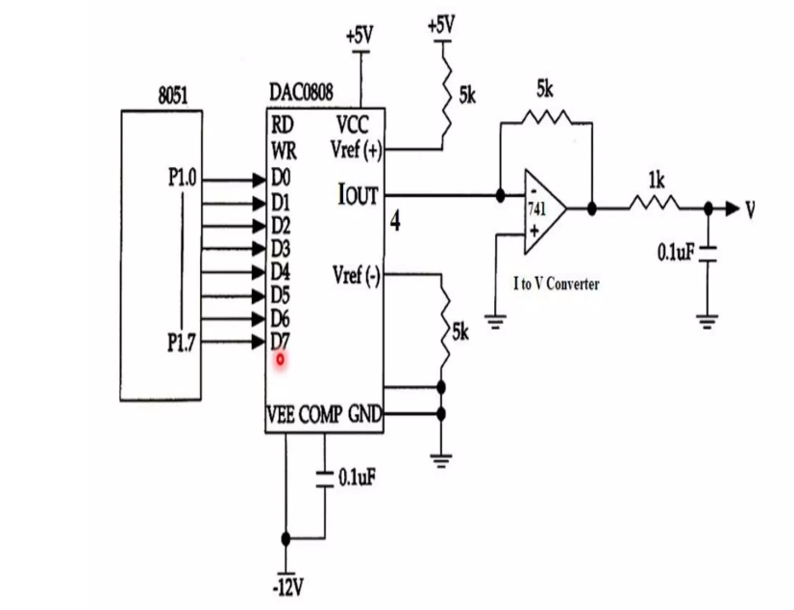
Interfacing DAC with 8051

Slide 30

DAC0808:
The digital inputs are converter to current (Iout), and by connecting a resistor to the Iout pin, we can convert the result to voltage
The total current provided by the Iout pin is a function of the binary numbers at the D0-D7 inputs of the DAC0808 and the reference current (Iref), and is as follows

Slide 31
we use 8-bit DAC 0808. This IC converts digital data into equivalent analog Current. Hence we require an I to V converter to convert this current into equivalent voltage.
Usually reference current is 2mA.
Ideally we connect the output pin to a resistor, convert this current to voltage, and monitor the output on the scope.

Slide 32
But this can cause inaccuracy; hence an opamp is used to convert the output current to voltage.
Now assuming that Iref = 2mA, if all the inputs to the DAC are high, the maximum output current is 1.99mA.

Slide 33
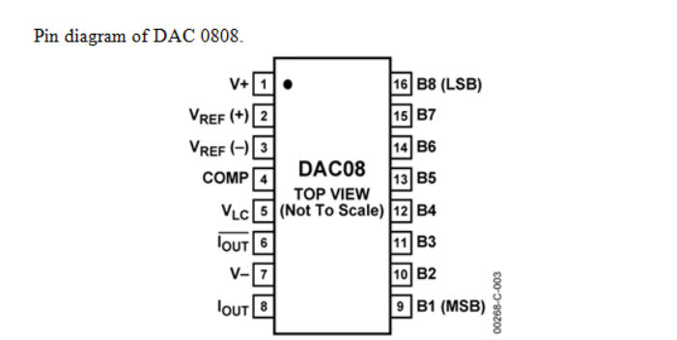
Pin diagram

Slide 34
Step1: Connect the P1 of 8051 with D0-D7 pins of DAC
Step2: Give +5v to VCC & Vref of DAC
Step3: Connect -12v to VEE of DAC
Step4: Connect OPAMP to OUT pin of the DAC With 5K resistor
Step5: Connect the oscilloscope to the OPAMP to View the output

